Slide 1
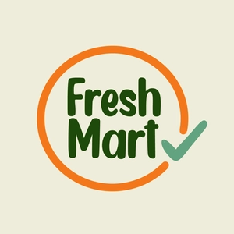
Fresh Mart
Karthik Ananthnarayan - 002964104
V. Vikyath Reddy - 002121618
Zheng Fang - 001066084
Ziwen Wang - 002127239

Slide 2

In this Presentation
Problem Statement and Solution
Style Guide
Product Objective
Target Audience
User Segmentation
User Needs
User Onboarding
Use Cases
Personas
UX Research Methods

Slide 3
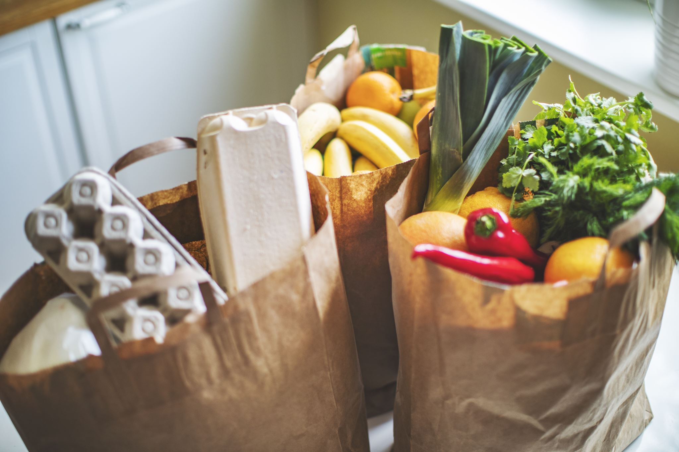
Problem statement and solution
Design a fresh organic grocery delivery application for Fresh Mart that allows Customers to have an enhanced shopping experience and lessen the gap between online and in-store shopping.
Created a mobile application which can handle several thousands of customers daily making hundreds of thousands of purchases. In time support and delivery offer best online grocery shopping experience

Slide 4
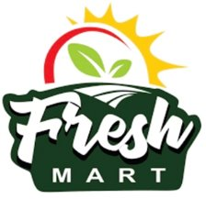
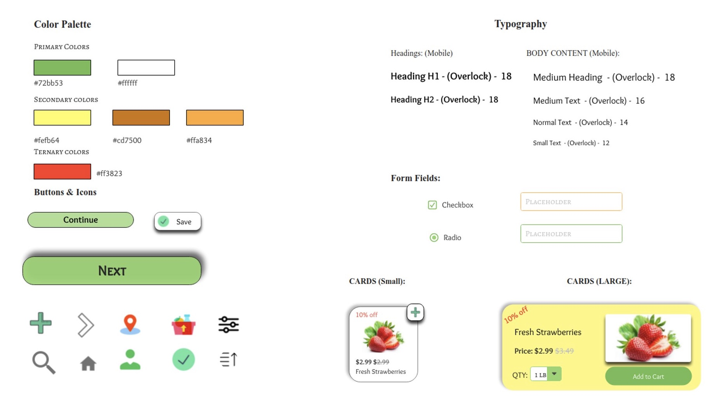
Style Guide

Slide 5
Product Objective
We are creating the design for Fresh Mart App's mobile application.
The purpose of the application is to assist nearby farmers in reaching a broader market opportunity with their food sales.
Anyone can use the mobile app to order for pickup or delivery.
Our app will only include organic, farm-fresh goods that come from regional farmers.
This App will allow the farmers to reach wider audience and the individuals who are not able to get out and purchase the vegetables from their local fields owing to time restriction.

Slide 6
Target Audience
User Base
Demographics – Includes people from cities and developed towns who generally use online apps to order groceries and find it difficult to go in-person to shop. Includes mainly 9:00 – 6:00 work force with busy lives.
Age Group – 16 to 60 years
Psychographics – Fear of finding the fridge empty. Also, the fear of not finding any fresh, organic veggies available.
Knowledge level – Almost all are educated and have an understanding of the need of product.
Technology Orientation – Mostly all are aware of technology and know how to operate apps on mobile phone.

Slide 7
User Segmentation
Name: Chuck Bass
I am a chemical Engineer and I live with a friend in Manhattan. He is very health conscious and avoid eating outside food. He loves travelling on weekends but due to his busy schedule he prefers ordering groceries online and he loves cooking and often opt for recipes online.
Age: 30
Occupation: Chemical Engineer
Consumer Needs:
Chuck wants to buy the best available product from the site.
He does not want to browse through various products to find the best one
Name: Lily Humphrey
I am a housewife. I generally shop for groceries and household stuff at a nearby supermarket and I want veggies to be fresh and healthy and I like picking my items on my own but as my kids are very young and I get less time for any other household things I use some online grocery apps for ordering groceries and fridge items quite often I love cooking and I keep on trying new recipes for my kids
Age: 40
Occupation: Home Maker
Consumer Needs:
Managing time to save time for kids
To effectively manage my kitchen and household stuff
To avoid eating out and lead a healthy life
Name: Jenny
I am a fashion student. I stay in a dormitory, and I need to complete my assignments on time as I am a college student and and I find it really difficult to go out and look for fresh vegetables. upon that I need to find products in a cheaper price
Age: 20
Occupation: student
Consumer Needs:
Managing time to complete assignments
To effectively manage my kitchen and college stuff
To avoid eating out and lead a healthy life
PRIMARY
SECONDARY
TERTIARY

Slide 8
User Needs
User-friendly grocery delivery application which is easy to use
High quality app with many features that comforts the users in terms of grocery recommendations and guest checkout
Various payment methods
Hassle-free process in navigation
Different vendors
Order tracking
24/7 support

Slide 9
User Onboarding
What is it?
The modals are pointing to the sections of your app that they are referring to, which is a little improvement over a first-look tour. This is why each modal's value should be tied directly to an interface component. It is typically employed to guide users through a series of steps they must do in order to arrive at a particular result.
Pros: You can also make these quickly in Appcues, Chameleon, UserPilot, or others.
Cons: They’re just as dismissible as the first look tour, but that’s not a reason not to do it.

Slide 10
Use cases
Middleweight Use Case
Loading/editing the shopping cart for fresh organic foods
Getting customer service/support
Login to the application
Heavyweight Use case
Groceries run for organic foods

Slide 11
Use Cases 1 – Login to the application
Use Case 1 | Login to the app
Actor | Fresh mart user
One day, a fresh mart user tries to login to his or her account
Alternative Flow 1 | The user enters a valid email address
Alternative Flow 2 | The user choice to enter their phone number
Alternative Flow 3 | The user is identified as a new user to fresh mart. The user enters their personal information for the new account. The user enters their desired password.

Slide 12
Use Cases 2 – Getting customer service/support
Use Case 2 | Getting customer service/ support
Actor | Fresh Mart User
One day, the user found out that he / her delivery of food is expired and want to talk to customer service. He / her login the fresh mart app.
Alternative Flow 1 | The user navigates to the user profile page and click ‘support’. And then they choice ‘Live Chat” for chatting with a customer service online through the app
Alternative Flow 2 | The user navigates to the user profile page and click ‘support’. And then they choice “Call” for calling with a customer service through the phone
Alternative Flow 3 | The user navigates to the user profile page and click ‘support’. And then they choice “Email” for contacting customer service through email

Slide 13
Use Cases 3 – Loading/editing the shopping cart
Use Case 3 | Loading/editing the shopping cart for fresh organic foods​
Actor​ | Fresh Mart User
One afternoon, The user starts loading the shopping cart to prepare the food for next week. With a clear budget in mind, they pick up food from the application, adds to the shopping cart, and removes items that are out of their current budget constantly​ | ​
Alternative Flow 1​ | To add an item, press the addition sign on the top right of that item​
Alternative Flow 2​ | To remove a single item, press the minus sign on the top right of that item (If the item has already been added to the shopping cart)​
Alternative Flow 3​ | To edit the shopping cart, press the addition or minus sign next to the item in the shopping cart​
Alternative Flow 4​ | To remove all items from the shopping cart, press the 'remove all' button under that item​

Slide 14
Use Cases 4 – Groceries run for organic foods
Use case 4 | General groceries run for a week
Actor | Fresh Mart User
Use Case Overview | One day, a user is doing groceries run from the app. they are adding and editing the items in the shopping cart. Soon they found out that some of items in the shopping cart are not available in the market and they are trying to find substitutes for it
Subject Area | Domestics
Actor(s) | Fresh Mart Users
Trigger | Order organic food from app
Precondition 1 | The user editing shopping cart
Precondition 2 | There is availability issue of the item

Slide 15
Basic flow for use case 4
Description | This scenario describes the situation where user is using Fresh mart app and giving instructions for items in the shopping cart before checkout process. This is the main success scenario.
1 | The user currently on the shopping cart page, they click ‘instruction’ under the item in the shipping cart
2 | The user choice their desired instructions for that item
3 | The user clicks ‘confirm’ for the instruction
4 | The user clicks ‘place order’ for entering checkout process
Termination | Checkout processes start

Slide 16
Alternative Flow 2A: Substitute needed
Description | This scenario describes the situation where the user need substitute if the current item is unavailable.
2A1 | The user choice ‘replace with other item’ in the instruction panel
2A2 | The user choice the substitute item from current market
2A3 | The user confirms the substitute item
Termination | Instruction is confirmed
Alternative Flow 2A: substitute is not needed
Description | This scenario describes the situation where the user does not need substitute if the current item is unavailable.
2B1 | The user choice ‘Don’t replace, refund item’
Termination | Instruction is confirmed

Slide 17

Persona
Name | Chuck
Age | 72
Occupation | Retired
Technical profile | Average attitude towards e-commerce website
Conditions | An older, retired man living alone in the city
Household income | $ 40,000 / year
Internet usage | News, e-book
Favorite sites | Walmart, Target
The role of farmer's fresh market | Customer

Slide 18

Persona
Name | Jimmy
Age | 19
Occupation | Student / part-time barista
Technical profile | Fanatic attitude towards e-commerce website
Conditions | College students focus on heavy coursework and work part-time at a coffee shop next to their school
Household income | $ 15,000 / year
Internet usage | Netflix, gaming
Favorite sites | eBay, Wayfair
The role of farmer's fresh market | Customer

Slide 19
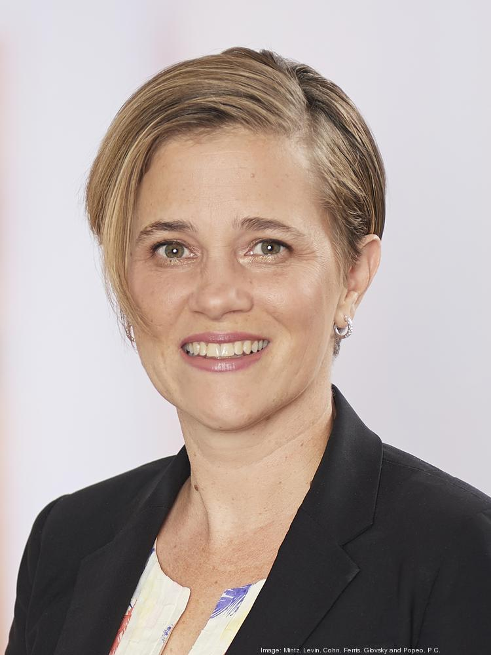
Persona
Name | Lily
Age | 50
Occupation | Attorney
Technical profile | Fanatic attitude towards e-commerce website
Conditions | Constant traveler and working at a company
Household income | $ 200,000 / year
Internet usage | News
Favorite sites | eBay, Wayfair
The role of farmer's fresh market | Customer

Slide 20

Persona
Name | Hailey
Age | 30
Occupation | Sales at a department store
Technical profile | Fanatic attitude towards e-commerce website
Conditions | A single mother with two kids
Household income | $ 50,000 / year
Internet usage | Online shopping / Netflix
Favorite sites | Amazon, eBay, Walmart
The role of farmer's fresh market | Customer

Slide 21
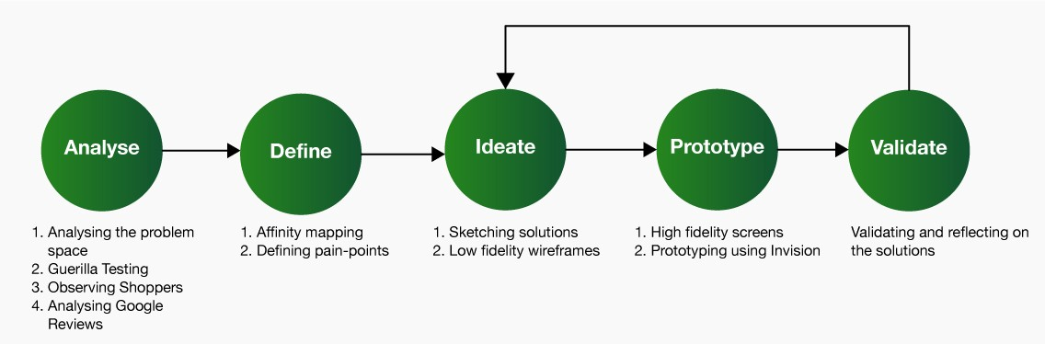
UX Research - Steps

Slide 22
UX Research - methods
Qualitative research methods like user interviews let me dive deep to ‘what’ the users are thinking and their current process of grocery shopping.
Guerilla Testing - 5 acquaintances were chosen, aged between 19–28. They were given a task to complete: To create a shopping cart from a shopping list provided to them. This was done to analyze how the user proceeds to pick products — through categories or through Search or both.
User persona - based on interviews and research results create an overview of our users, their personalities, goals, and pain points.
Prototyping - explore ideas before implementing them by creating a mock-up of the site. A prototype can range from a Hi-Fi mock-ups to interactive HTML pages.
First Click Testing - A testing method focused on navigation, which can be performed on a functioning website, a prototype, or a wireframe..
System usability testing - SUS is a technology-independent ten-item scale for subjective evaluation of the usability
Validation Testing - This is done to map solutions to from design flow and user stories through the prototype testing.

Slide 23
Usability Testing Objectives and Tasks
Task 1
User shops through app from home.
User wants to buy some veggies.
Found all the items needed and selected delivery on same day for order.
Task 2
User shops through app from home.
User was given a discount offer/deal
Where is the user going to find deal/offer.
Task 3
User shops through app from home.
Find out the where to track the order.

Slide 24



Error Handling
Correction
Recovery
Prevention
Let users know as soon as they make a mistake
Make errors prominent
Show error messages in context
Ensure messages are easy to understand and helpful

Slide 25
References
UX Design Bootcamp
Adobe UX Industry methods and Trends 2020
https://persona.qcri.org/blog/how-to-use-personas-listing-typical-persona-use-cases/
https://xd.adobe.com/ideas/process/user-research/user-segmentation-for-ux-design/
https://www.interaction-design.org/literature/topics/ux-research

Slide 26
THANK YOU

